Slide 1

PREDICTING THE CHANCES OF A CLINICAL TRIAL COMING TO A COMPLETION OR BEING TERMINATED

Slide 2
Group Members
Janet Cheserem - Team Lead
Colleta Wamalwa

Slide 3
INTRODUCTION OF THE DATASET
This dataset captures details from ClinicalTrials.gov, featuring over 30 key attributes. It provides information on clinical trials, such as their ID, title, status, purpose, treatments, sponsors, participant info, and more. These attributes offer a holistic view of the trials, helping us understand their goals, progress, and potential impacts on healthcare and research.

Slide 4

Objectives
To carry out an extensive Exploratory Data Analysis to uncover hidden patterns.
To develop a machine learning model for clinical studies to help predict the completion or termination of a clinical trial.

Slide 5
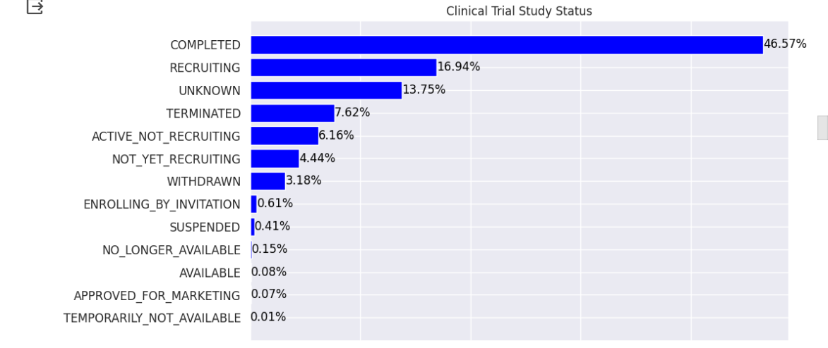
What is the success rate of the studies?

Slide 6
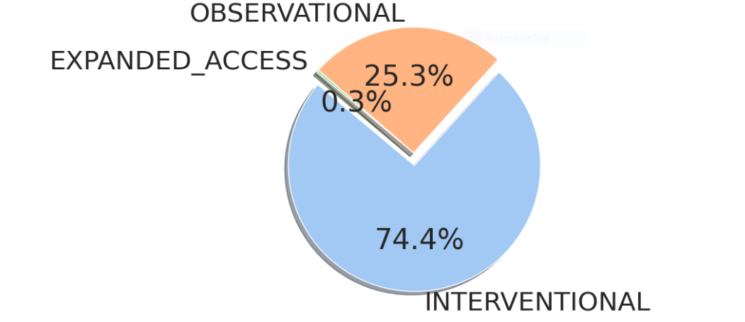
What is the commonly used type of approach?

Slide 7
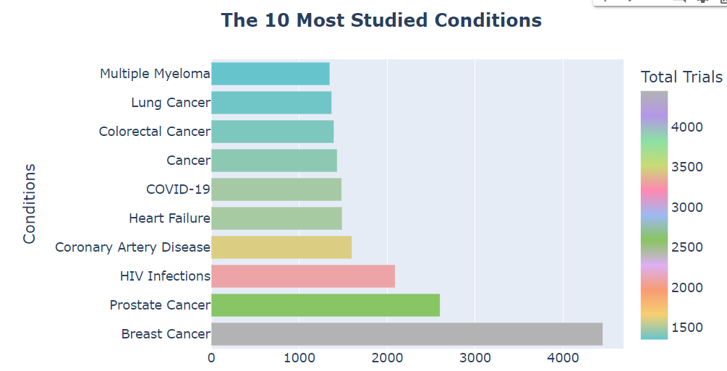
Which diseases have the attention of clinical studies?

Slide 8
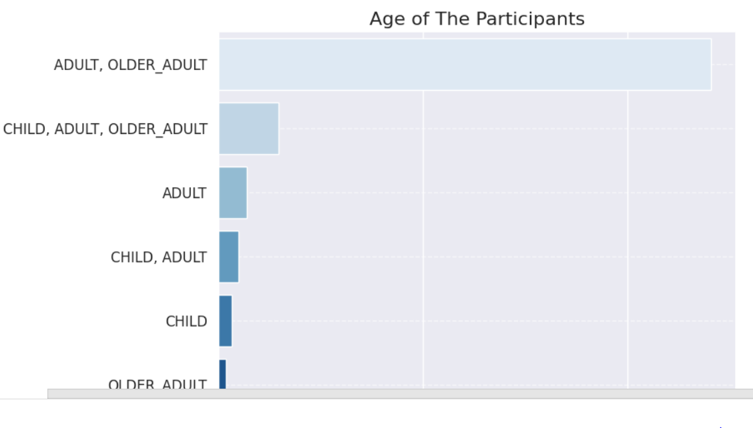
Which age group do the studies lean towards?

Slide 9
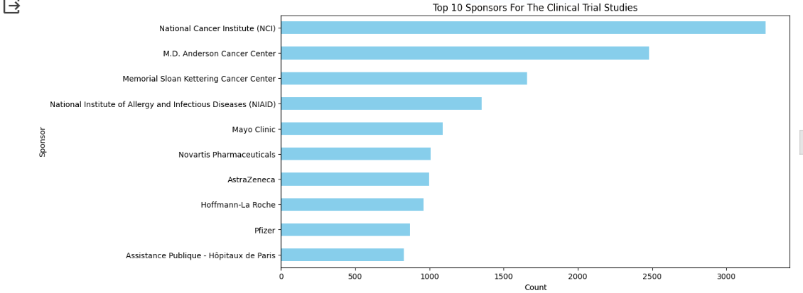
Who are the top sponsors of the clinical trials?

Slide 10
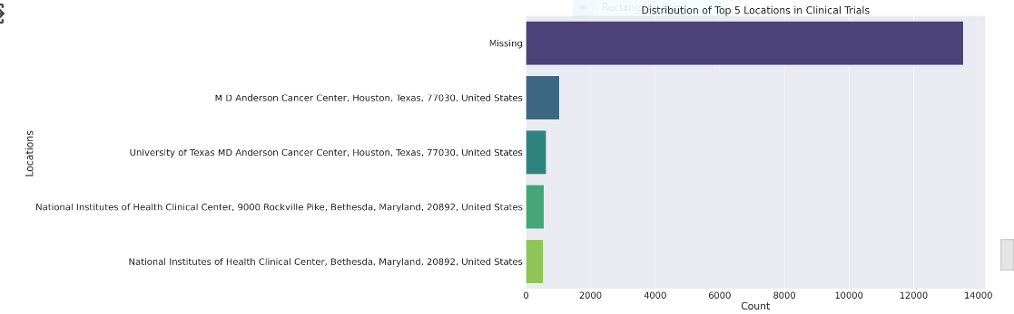
What are the prominent hubs for clinical trials?

Slide 11
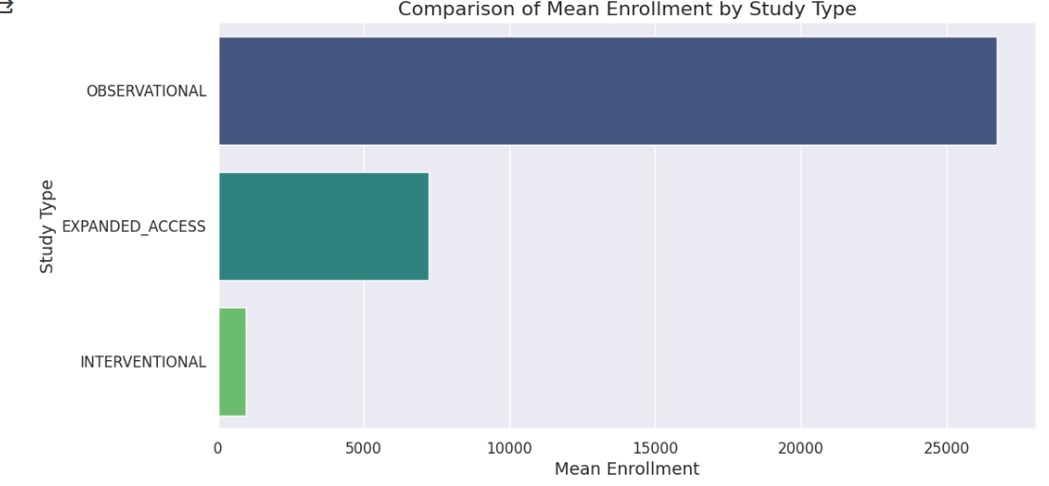
Is there a rshp between the choice of study type and the number of participants enrolled?

Slide 12
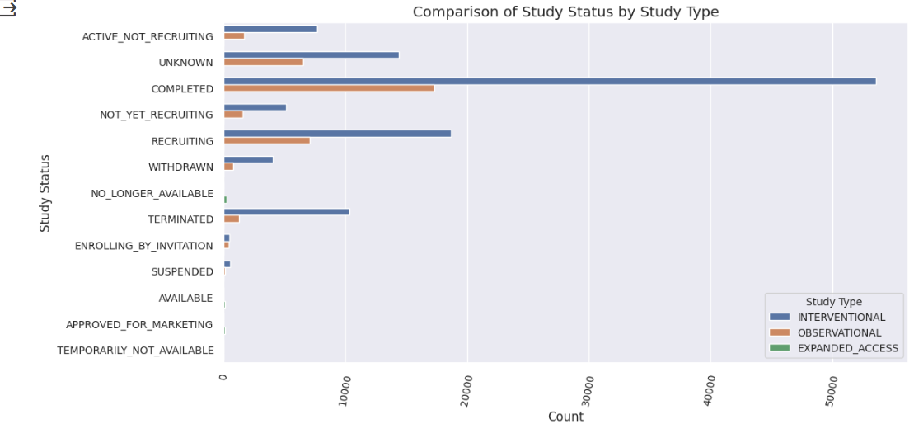
Is there a rship between the choice of study type and the status of the studies?

Slide 13
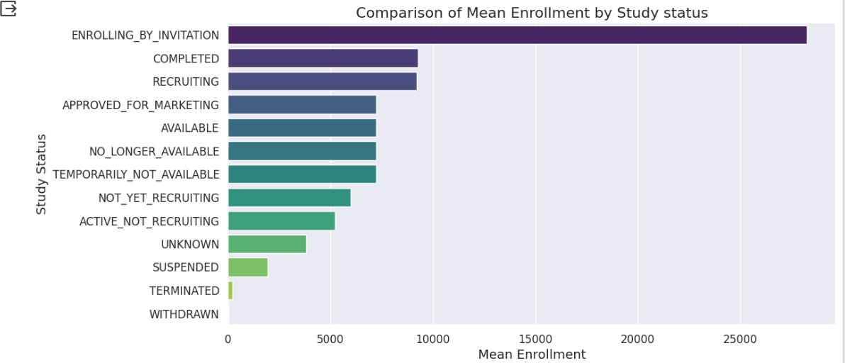
Is there a rshp between the number of participant and the progress of the trial?

Slide 14
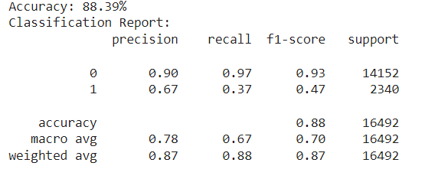
MODEL
Our model performed well with an accuracy of 88.39%. However, there are areas for improvement that we will work on later.

Slide 15
Recommendation
Given the prominence of cancer-related diseases, HIV/AIDS, heart disease, and COVID-19 in clinical studies, it is crucial to continue investing in research and allocating resources to these areas
For areas with ongoing research, maintaining a system that monitors the progress and success rates of clinical studies is essential.
While established research hubs are important, it's vital to promote a more balanced distribution of clinical studies to benefit a broader population.
For studies with unknown or terminated statuses, there is a need for in-depth analysis to understand the reasons behind these outcomes.
There is need for more collaboration with major sponsors in the clinical trials for impactful partnerships and funding hence successful clinical trials.

Slide 16
.
Q & A

Slide 17
THE END
THANK YOU!!

